Slide 1


Slide 2

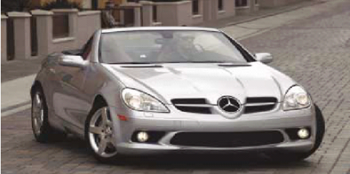
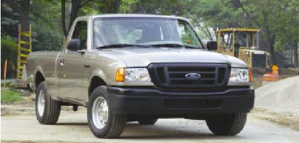
Fitness for use
  how well product or service does what it is supposed to
Quality of design
  designing quality characteristics into a product or service
A Mercedes and a Ford are equally “fit for use,” but with different design dimensions
3-<number>

Slide 3

Quality of Conformance
  Making sure a product or service is produced according to design
    if new tires do not conform to specifications, they wobble
    if a hotel room is not clean when a guest checks in, the hotel is not functioning according to specifications of its design
3-<number>

Slide 4


Consumer’s and producer’s perspectives depend on each other
Consumer’s perspective: PRICE
Producer’s perspective: COST
Consumer’s view must dominate
The ability to consistently meet or exceed customer satisfaction
3-<number>

Slide 5

Meaning of Quality
Producer’s Perspective
Consumer’s Perspective
Quality of Conformance
Quality of Design
Production
Conformance to specifications
Cost
Quality characteristics
Price
Marketing
Fitness for
Consumer Use
3-<number>

Slide 6

Performance
  basic operating characteristics of a product; how well a car is handled or its gas mileage
Features
  “extra” items added to basic features, such as a stereo CD or a leather interior in a car
Reliability
  probability that a product will operate properly within an expected time frame; that is, a TV will work without repair for about seven years
3-<number>

Slide 7

Conformance
  degree to which a product meets pre–established standards
Durability
  how long product lasts before replacement
Serviceability
  ease of getting repairs, speed of repairs, courtesy and competence of repair person
3-<number>

Slide 8

Aesthetics
  how a product looks, feels, sounds, smells, or tastes
Safety
  assurance that customer will not suffer injury or harm from a product; an especially important consideration for automobiles
Perceptions/perceived quality
  subjective perceptions based on brand name, advertising, and the like
3-<number>

Slide 9

Tangibles
Time and Timeliness
  How long must a customer wait for service, and is it completed on time?
  Is an overnight package delivered overnight?
Completeness:
  Is everything customer asked for provided?
3-<number>

Slide 10

Courtesy:
  How are customers treated by employees?
  Are catalogue phone operators nice and are their voices pleasant?
Consistency
  Is the same level of service provided to each customer each time?
Accessibility and convenience
  How easy is it to obtain service?
  Does a service representative answer you calls quickly?
3-<number>

Slide 11

Accuracy
  Is the service performed right every time?
  Is your bank or credit card statement correct every month?
Assurance – The knowledge exhibited by personnel who come into contact with customer and their ability to convey trust and confidence
Responsiveness
  How well does the company react to unusual situations?
  How well is a telephone operator able to respond to a customer’s questions?
3-<number>

Slide 12
DETERMINANTS OF QUALITY
Quality of design – Intension of the designers to include or exclude features in a product or service (Quality in car design)
Quality of conformance – The degree to which goods or services conform to the intent of the designer (Performance of tube light)
Ease of use – The determination of quality does not stop once the product or service has been sold. User instruction is important (Earlier SIEMENS mobile set)
Service after delivery – For a variety of reasons, products do not perform as expected. It is important to bring the product or service up to the standard (Replacing problematic device)

Slide 13

Loss of business
Liability
Productivity
Costs
2-<number>

Slide 14
THE COSTS OF QUALITY
Category | Description | Examples
Appraisal cost | Costs related to measuring, and auditing materials, parts, products, and services to assess conformance with quality standard | Inspection equipment, testing, labs, inspectors, and the interruption of production to take samples
Prevention cost | Costs related to reducing the potential for quality problems | Quality improvement programs, training, monitoring, data collection and analysis, and designing
Internal failure cost | Costs related to defective products or services before they are delivered to the customers | Rework cost, problem solving, material and product losses, scrap and downtime
External failure cost | Costs related to delivering substandard products or services to customers | Returned goods, reworking costs, warranty costs, loss of goodwill, liability claims and penalties

Slide 15

Total Quality Management (TQM)
Kaizen
Quality at source
Pokayoke
2-<number>

Slide 16

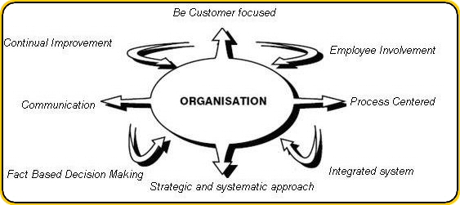
2-<number>

Slide 17

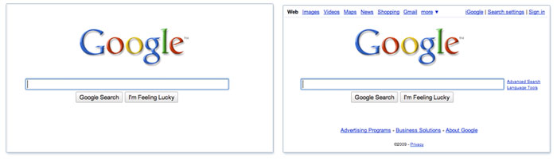
2-<number>

Slide 18

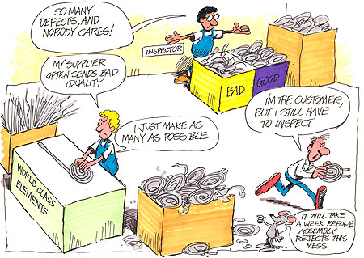
2-<number>

Slide 19


2-<number>

Slide 20

Flowcharts
Check sheets
Histograms
Pareto analysis
Scatter Diagram
Control Chart
Cause and Effect Diagram
2-<number>

Slide 21
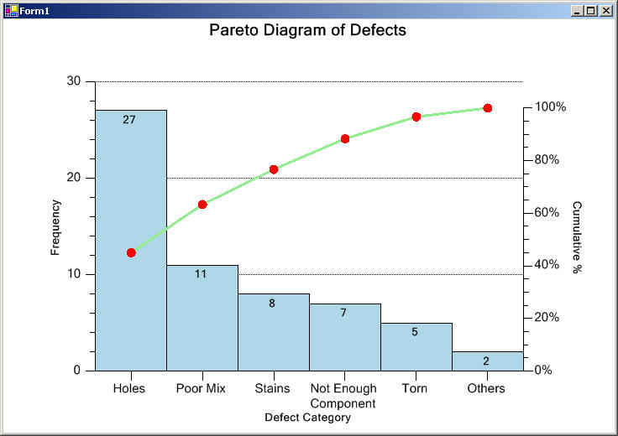

2-<number>

Slide 22
The police department collected all the tickets on a weekend. Tickets were given for committing infraction. Make a check sheet and Pareto diagram
Ticket Number | Infraction | Ticket Number | Infraction
1 | Speed excessive | 14 | Expired Inspection
2 | Expired Inspection | 15 | Parking Violation
3 | Improper turn | 16 | Improper turn
4 | Speed excessive | 17 | Parking Violation
5 | Parking Violation | 18 | Speed excessive
6 | Parking Violation | 19 | Parking Violation
7 | Speed excessive | 20 | Parking Violation
8 | Parking Violation | 21 | Parking Violation
9 | Improper turn | 22 | Speed excessive
10 | Parking Violation | 23 | Parking Violation
11 | Parking Violation | 24 | Parking Violation
12 | Parking Violation | 25 | Speed excessive
13 | Speed excessive | 26 | Parking Violation
2-<number>

Slide 23
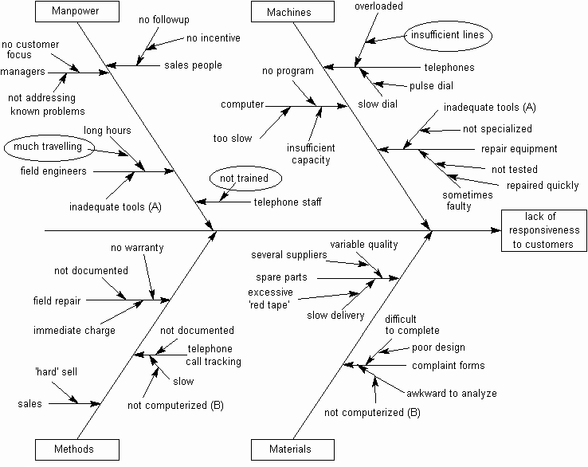
2-<number>

Slide 24
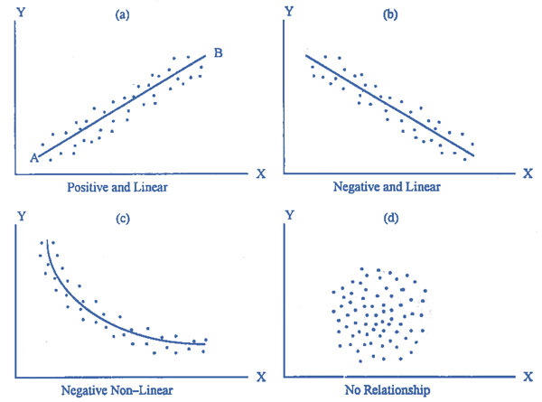
2-<number>

Slide 25
Draw Scatter diagram and explain
Age | Absenteeism rate
24 | 6
30 | 5
22 | 7
25 | 6
33 | 4
27 | 5
36 | 4
58 | 1
37 | 3
47 | 2
54 | 2
28 | 5
42 | 3
55 | 1
2-<number>

Slide 26
STATISTICAL PROCESS CONTROL & CONTROL CHART
Statistical Process Control:
  Statistical evaluation of the output of a process during production
Control Chart:
  Purpose: to monitor process output
  Used to distinguish between random variability and nonrandom variability
  Upper and lower control limits define the range of acceptable variation

Slide 27
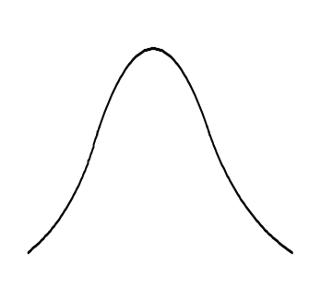


SOME DEFINITIONS RELATED TO CONTROL CHART
Random Variation: Natural variation in the output of a process, created by countless minor factors.
Assignable Variation: In process output, a variation whose cause can be identified.
Sampling distribution & Process distribution
Sampling
distribution
Process
distribution
Mean
Sampling distribution is a normal distribution, If output reflects random variability, the process is stable. Otherwise vice versa.

Slide 28



SOME DEFINITIONS RELATED TO CONTROL CHART (CONTD.)
Normal Distribution property
Approximately 95.5% of values will be within ±2 standard deviation and 99.7% values will be within ±3standard deviation.
σ = Standard deviation
Sampling
distribution
−3σ
−2σ
Mean
+2σ
+3σ
Process
distribution
95.44%
99.74%
Mean
Lower control
limit
Upper control
limit

Slide 29
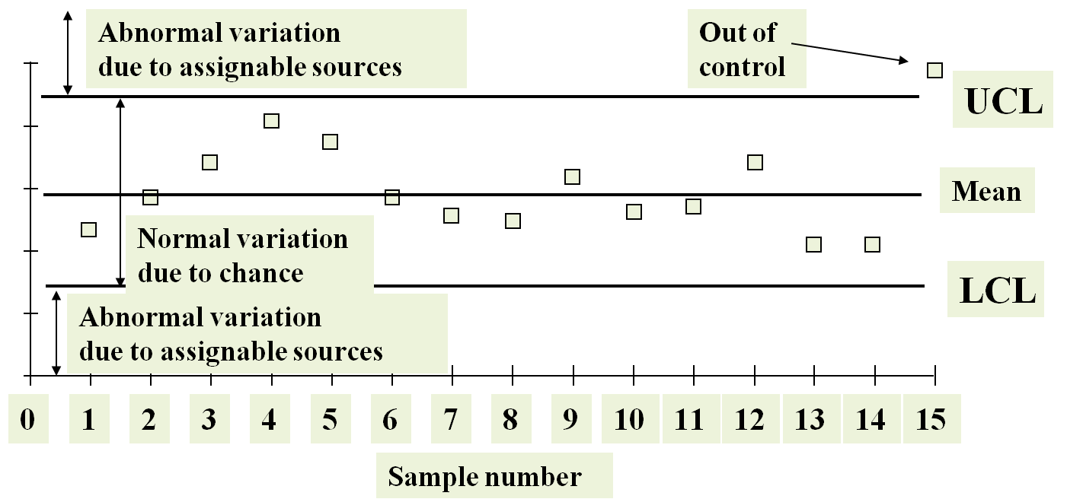
CONTROL CHART (CONTD.)

Slide 30
SOME DEFINITIONS RELATED TO CONTROL CHART (CONTD.)
Variables: Generate data that are measured (Amount of time needed to complete a task)
Attributes: Generate data that are counted (Number of defective parts in sample)
  There are two types of Control Chart –
    Control charts for variables
      Mean charts
      Range charts
    Control charts for attributes
      p - chart
      c - chart

Slide 31

MEAN & RANGE CHART (CONTD.)
Mean Chart - Used to monitor the central tendency of a process
Sampling
Distribution
(process mean is
shifting upward)
UCL
x-Chart
Detects
shift
LCL
UCL
Does not
detect shift
R-chart
LCL

Slide 32

MEAN & RANGE CHART (CONTD.)
Range Chart - Used to monitor the process dispersion
Sampling
Distribution
(process variability is increasing)
UCL
Does not
reveal increase
x-Chart
LCL
UCL
R-chart
Reveals increase
LCL

Slide 33
Processing of a new account in HSBC is intended to take 10 mins on average. Five samples of four observations are taken. Management is decided to take 95.5% value as random variation. The standard deviation is known from experience as .02.Is the process in control?
Sample 1 | Sample 2 | Sample 3 | Sample 4 | Sample 5
10.2 | 10.3 | 9.7 | 9.9 | 9.8
9.9 | 9.8 | 9.9 | 10.3 | 10.2
9.8 | 9.9 | 9.9 | 10.1 | 10.3
10.1 | 10.4 | 10.1 | 10.5 | 9.7
2-<number>

Slide 34
USE OF P - CHART
When observations can be placed into two categories.
  Good or bad
  Pass or fail
  Operate or don’t operate
When the data consists of multiple samples of several observations each

Slide 35
USE OF C - CHART
Use only when the number of occurrences per unit of measure can be counted;
  Scratches, chips, dents, or errors per item
  Cracks or faults per unit of distance
  Breaks or Tears per unit of area
  Bacteria or pollutants per unit of volume
  Calls, complaints, failures per unit of time

